Slide 1
ENIGMA 551
WDK
Evan Lang, Long Chen, Mayra Teixeira, Shizhe Yang

Slide 2
Motivation
The Enigma machine was a sophisticated and historically significant cipher machine. Used by Germany in WW2, the importance of cracking it’s codes directly lead to the modern computing revolution
Porting this technology to a small FPGA enables high quality encryption in the palm of one’s hand
Evan

Slide 3
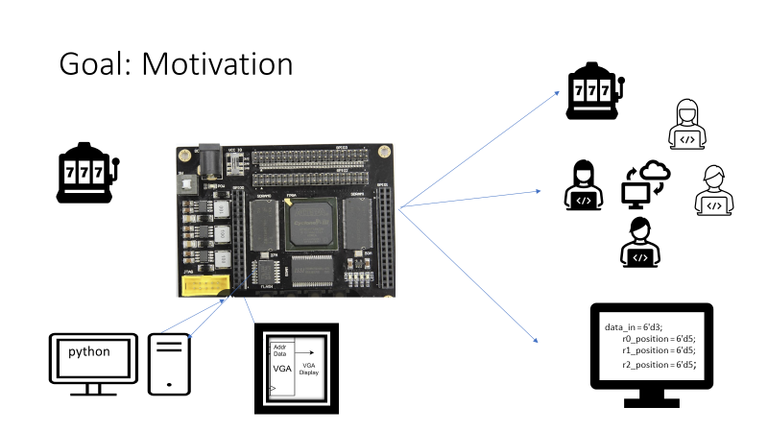
Discover the power of privacy with our cypher machine. Secure, reliable. Safe to use. Changing the way of communication!!
Mayra and shizhe

Slide 4
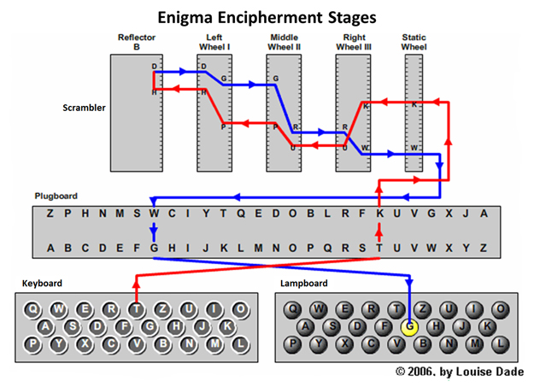
Enigma Architecture:Traditional
This is the most common Enigma Machine that was used by people.
A key is pressed on the keyboard, and then is sent to the plugboard
Coming out of Plugboard, letter will be mapped through ROTOR3->ROTOR2->ROTOR1.
Reflector has the same mechanism as Plugboard.
Coming out of the Reflector, the letter will be mapped in reverse through ROTOR1->ROTOR2->ROTOR3.
Coming out of the last rotor, the letter will be mapped through Plugboard again
The light on lampboard will turn on for the corresponding encrypted letter.
Shizhe

Slide 5
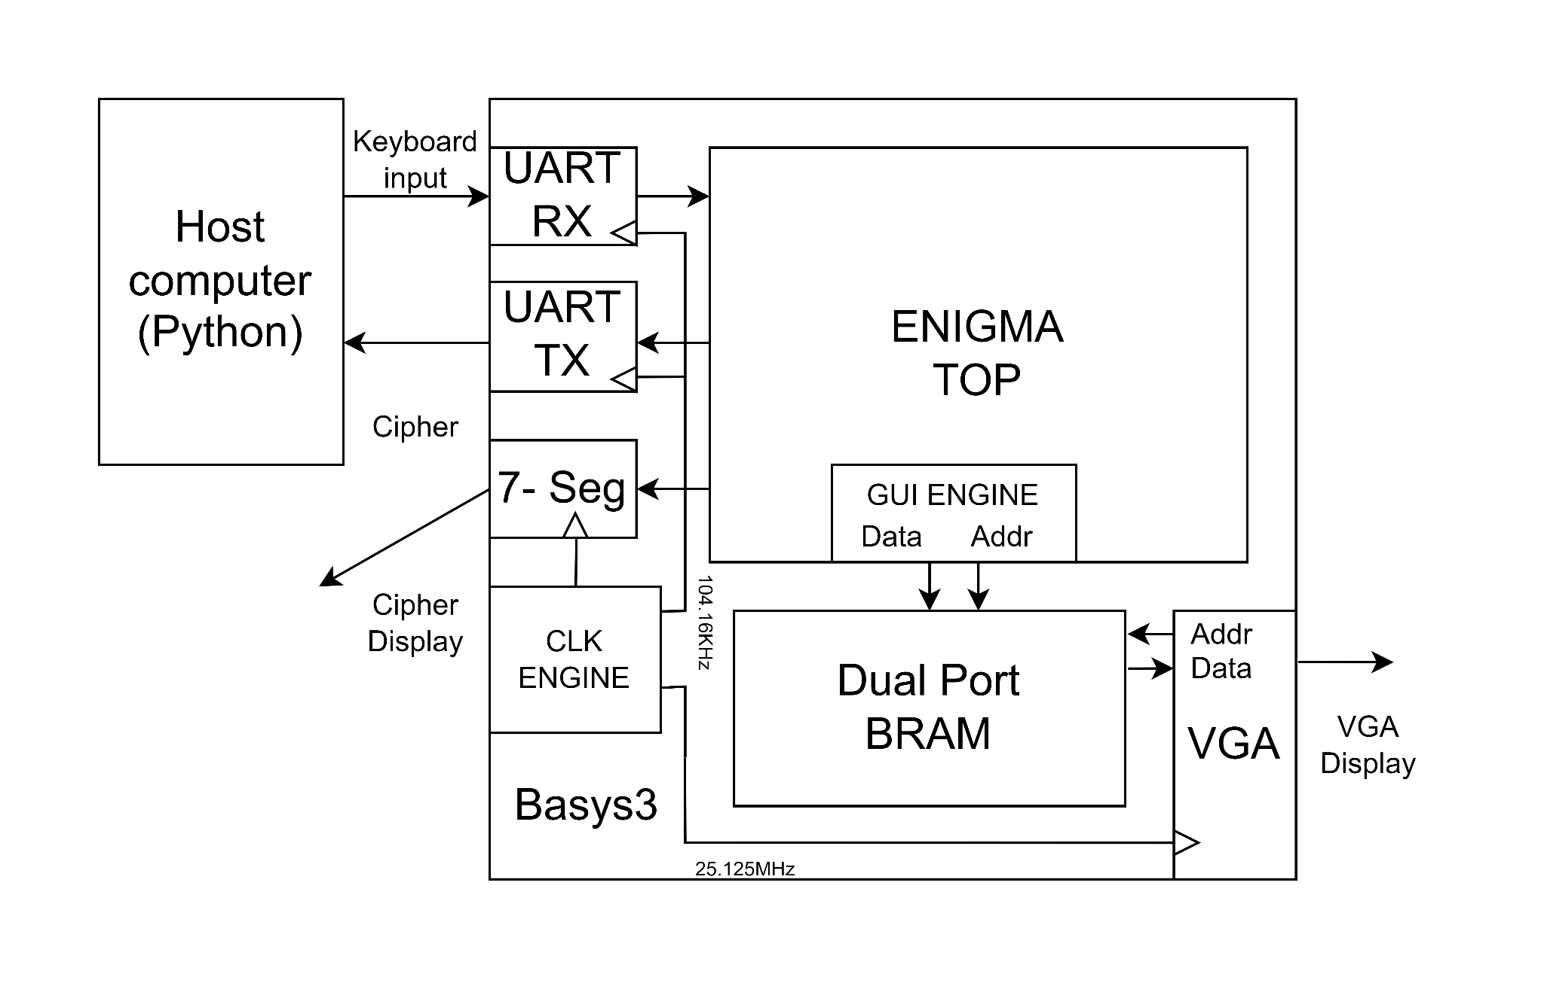
Top Level Architecture
Data sent and received by python program through
9600 Baud Rate UART
Combinational Cipher Core
Clk and pipeline free
Triggered on new input
28K Dual Port BRAM
12 bits RGB 4: 4: 4 data
4096 different colors
640 x 480 VGA
Mapping 16 pixels to 1 addr
Clk Engine
Drive peripherals
Long

Slide 6
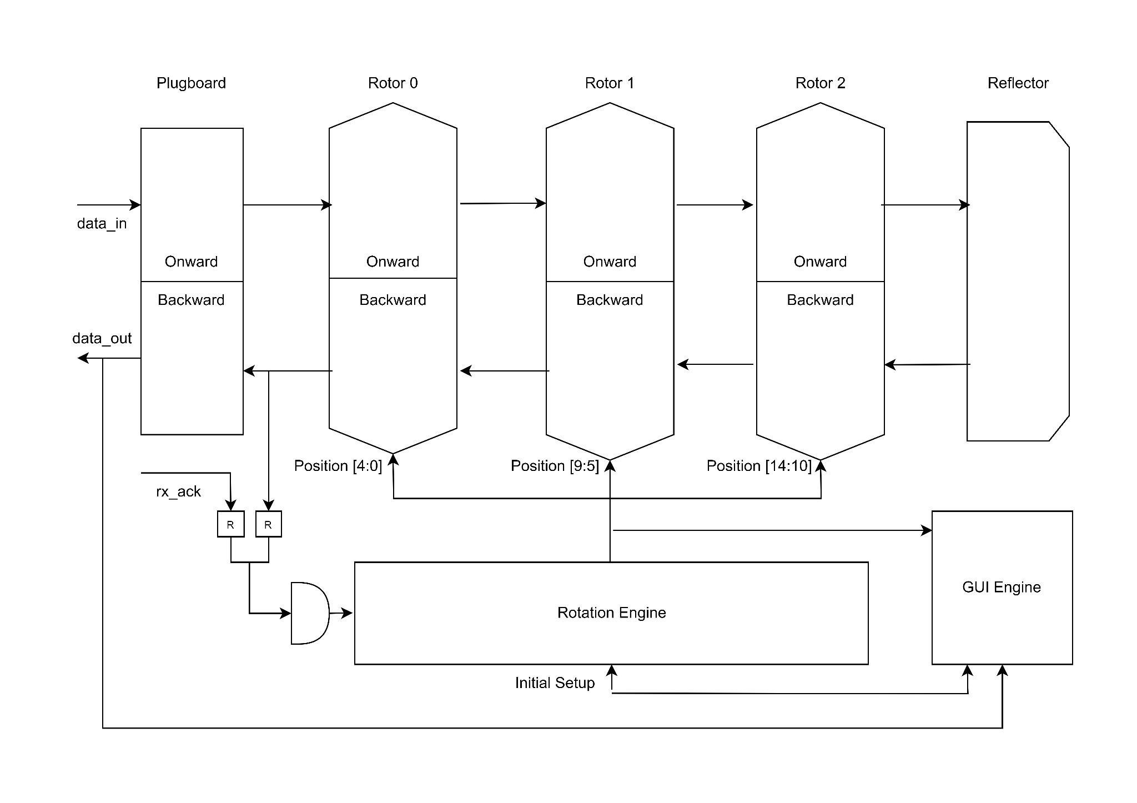
Enigma Architecture in FPGA
Rotation Engine
drives the position of all Rotors
triggered by data_out & rx_ack
Rotor
Dynamic Mapping based on
its position
Moves one step further after each
input, 26 different positions for each rotor
Plugboard
Reconfigurable Mapping
GUI Engines
Collect rotor setup & position
Collect data_out
Modify RAM for visuals
Long & Shizhe

Slide 7
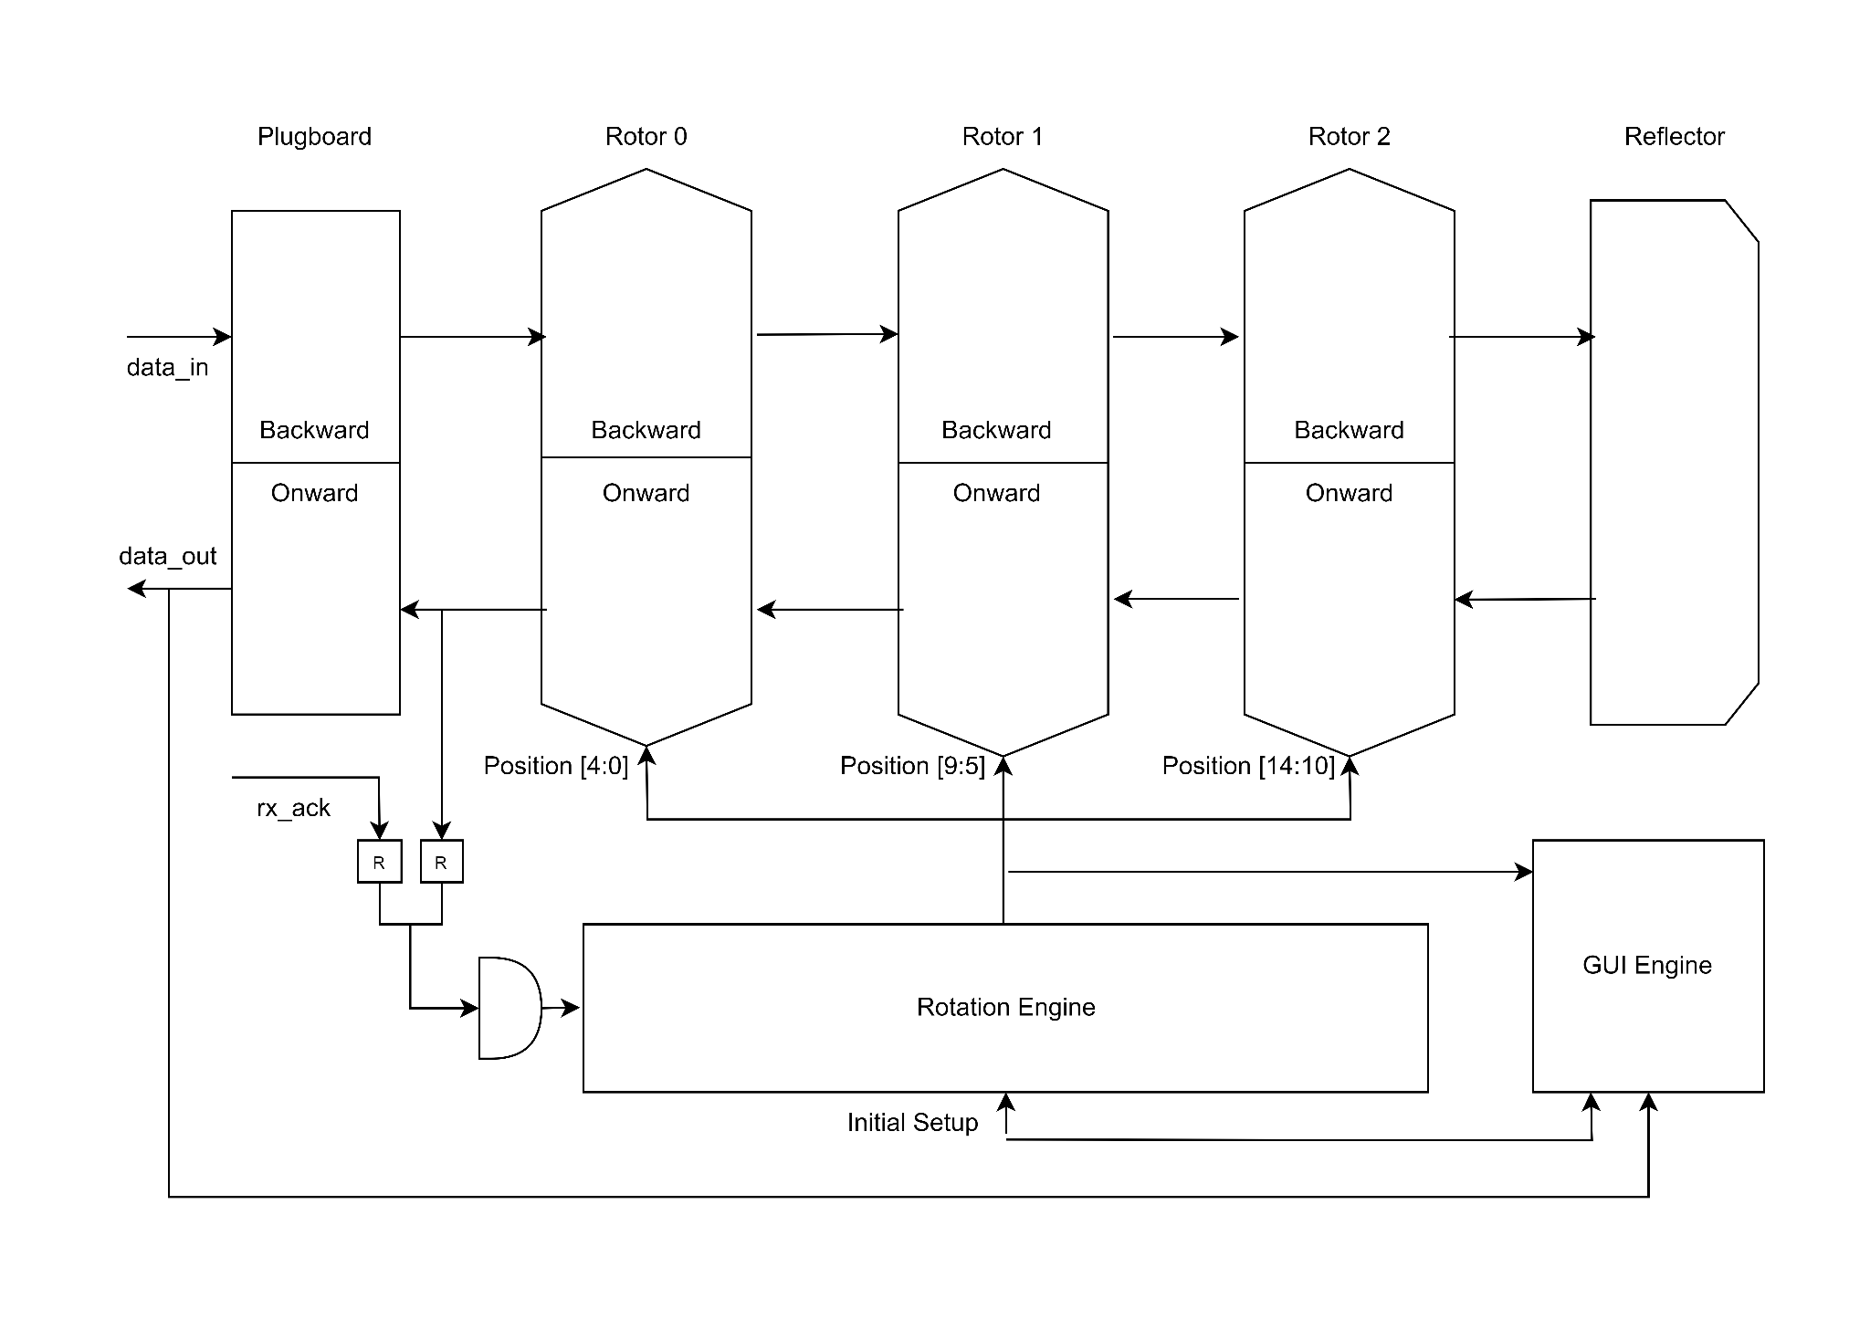
Decipher Enigma
Verilog confines
Non-reversible wire route
New instance for decipher
Reversed routing
Retrograde entry to “Backward”
Original code out from “Onward”
Rotor & Plugboard
Reconfigurable Mapping
Long&Shizhe

Slide 8
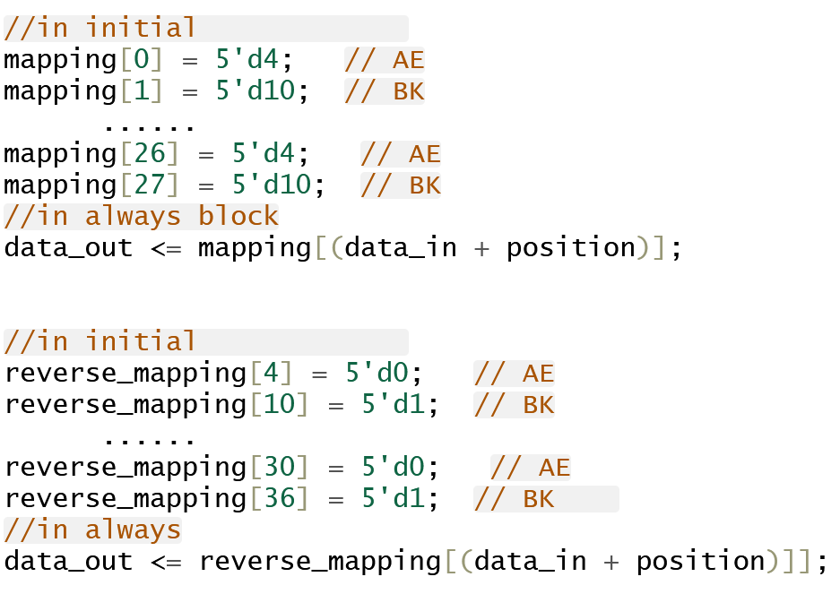
Mapping
Mapping:
Map each character accordingly by (input stream+current position)
Rotor Mapping differs
Reversible by reverse rotation
To avoid the mapping out of index problem, we do an increment of index but simply it is just shifting the bits.
Shizhe

Slide 9
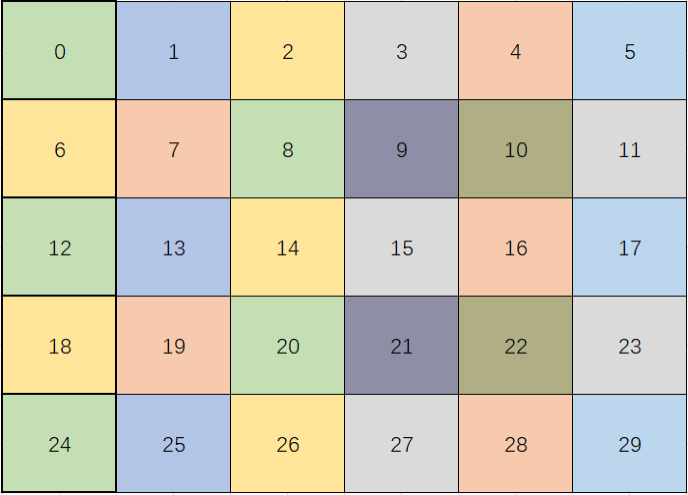
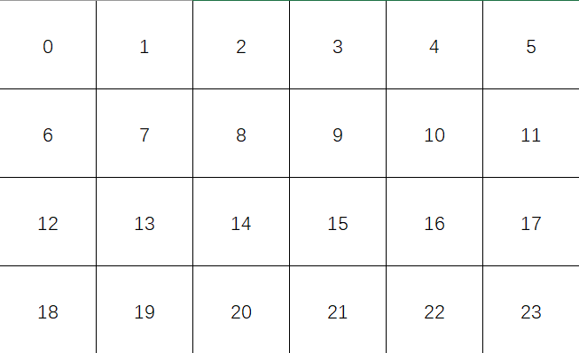
VGA
Starting from the upper left corner, refresh pixels by lines
Hsync triggered when reach end of a line
Long

Slide 10
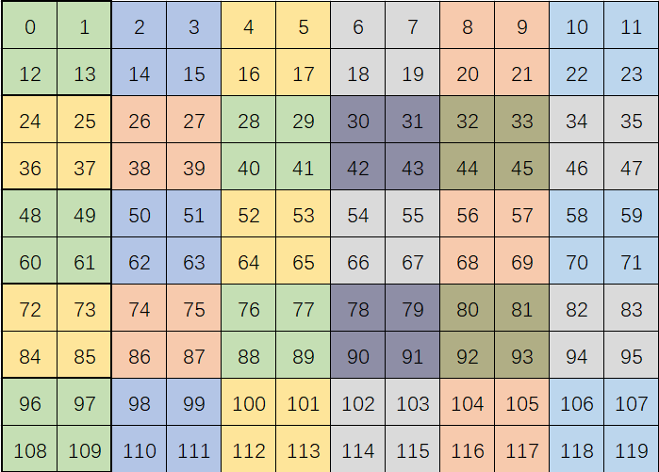
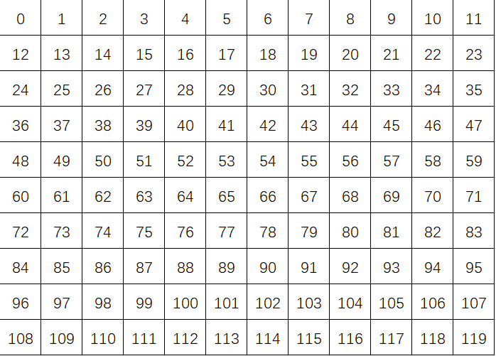
VGA - Mem Limit
Resource limitation on RAM
Pixel downscale mapping — —>
Mem array 160 x 120
Upscale to 640 x 480 on screen
Long

Slide 11
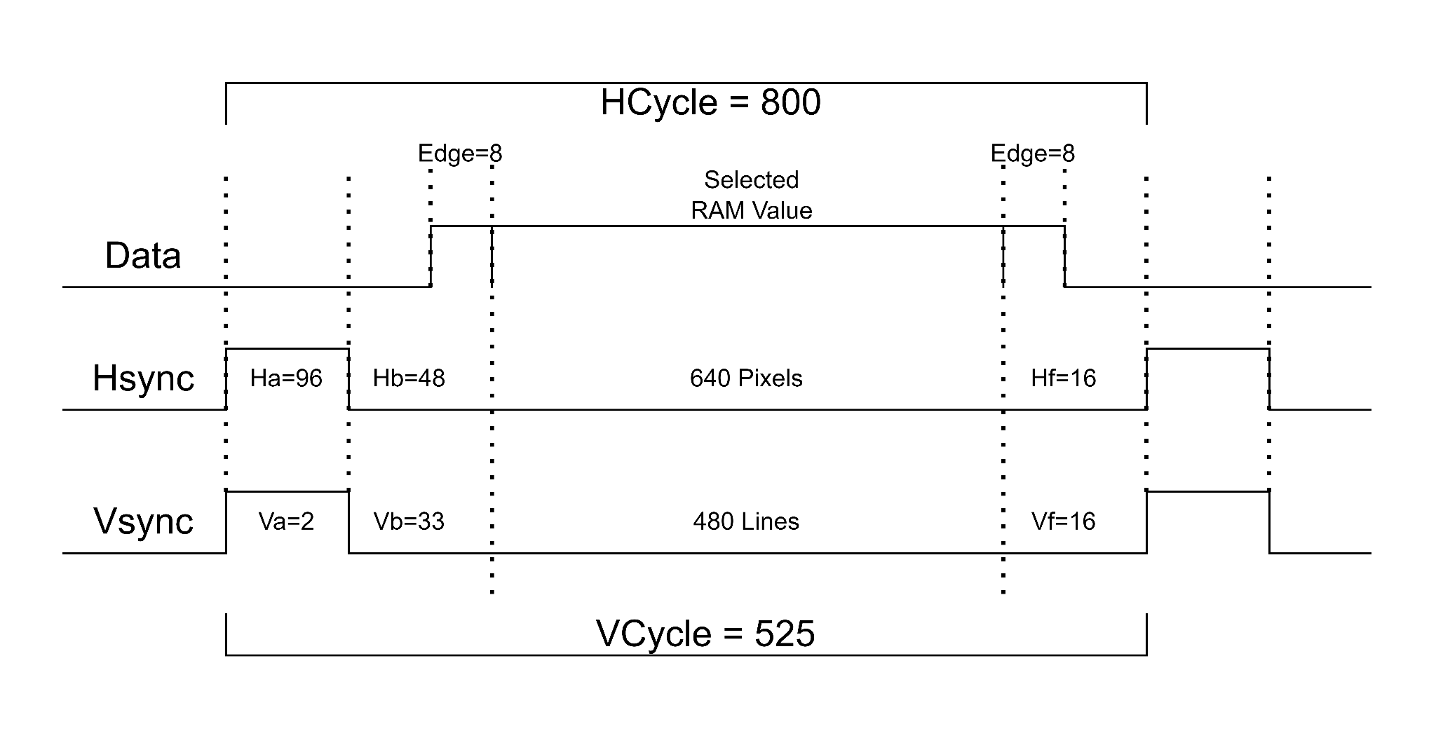
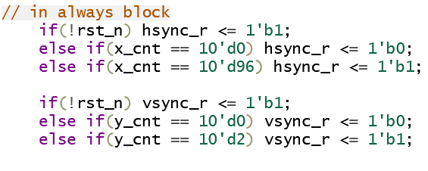
VGA
Generate Sync Pluses
Long

Slide 12
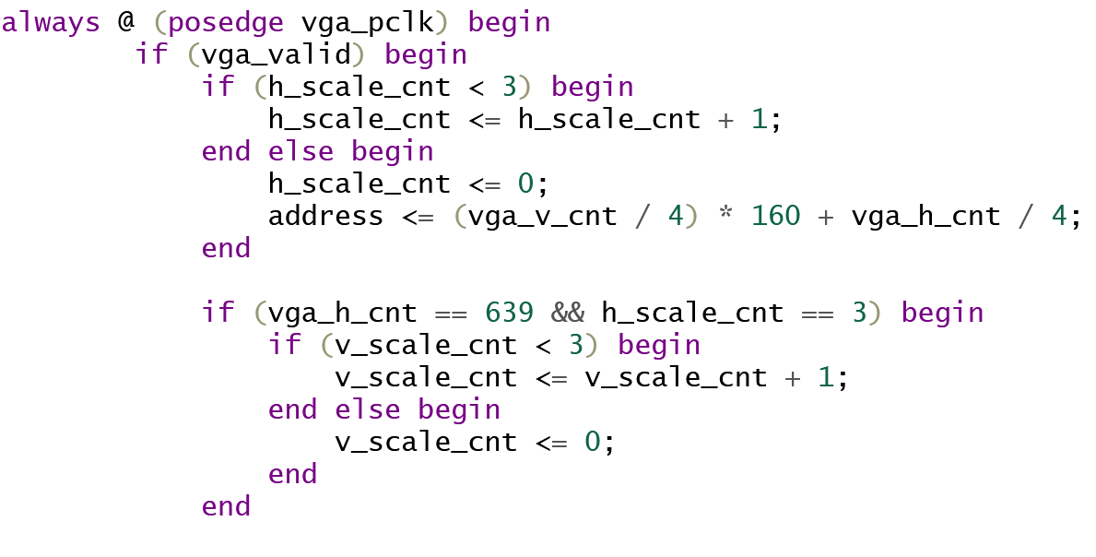
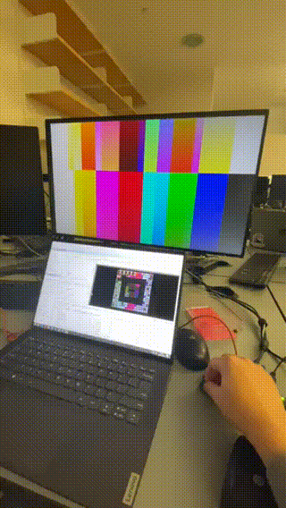
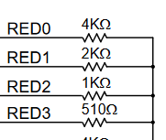
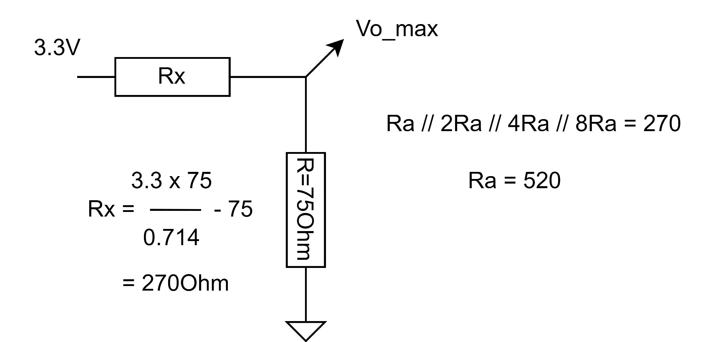
VGA
16 to 1 down scale
Based on Horizontal and Vertical counter
Get macroblock address (mapping to RAM)
Image Projection
RGB 4:4:4 0000_1111_0000
- Mapping to VGA resistor net
- 0~0.714V Analog output
- Generate 16 voltages steps at pin
- Stored and to be modified in RAM
Long

Slide 13
ENIGMA ENCODING ALGORITHM
1.Plugboard maps letters through pairs. It can potentially produce C(26!/(2 !(26!-2!)))pairs.
2.For Rotors, the algorithm is as follows: Pick a starting point for each rotor
When data is transmitted once, rotor1 advances one time.
When rotor 1 advances 26 times, it goes back to the original point
Then rotor 2 advances 1 time.
When rotor 2 advances 26 times, it goes back to the original point
Then rotor 3 advances 1 time.
When rotor 3 advances 26 times, it goes back to the original point
The above steps repeat until all three rotors return to their original points.
We can choose any set of starting points for the rotors.
3.Reflector and Lampboard are just another form of plugboard that each possess the number of combinations that plugboard has.
It is estimated that the conventional Enigma machine has approximately 16 quintillion combinations.(However, the rotor rotation mechanism is also its weakness)
Shizhe

Slide 14
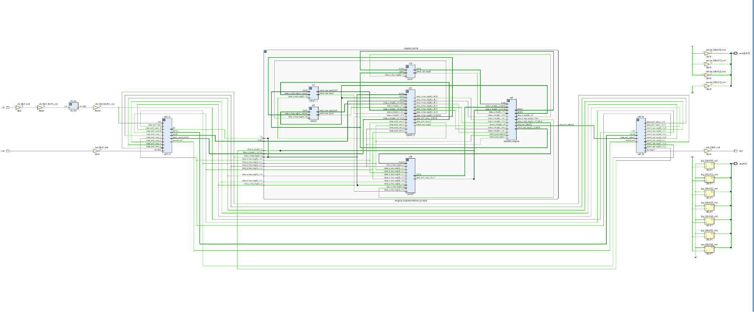
The full schematic

Slide 15
Functionality Test
Critical Point: Synchronization of Rotors
In real Enigma Machine, rotors are mechanically connected.Butin FPGA, we need to make sure that the rotors are rotated synchronously. In order to achieve this, sensitivity list only needs to include data input stream.
Shizhe is responsible for synchronizing the rotors and building the implementation for enigma machine and Mayra is responsible for test bench and verifications.
Test would include:
Encryption: From Rotor0 to Rotor2, check if letters are mapping correctly.
Encryption: From Rotor2 to Rotor0, check if letters are mapping correctly.
Rotation: Rotors need to be synchronized.Check the waveform for synchronization.
Reflector,plugboard and Lampboard: Same functionality but different mappings.
Decryption:From rotor2 to rotor1, check if letter are reverse mapped correctly according to their respective positions.
Decryption: Check reverse rotation is synchronized when position rotates backward.
Uart: Uart receives bits one by one and we need to use a shift register. It will have a 8bits hexadecimal input.We need to convert the input into the bits we need.
7 segment: Need to clearly display the encrypted input.
Shizhe

Slide 16
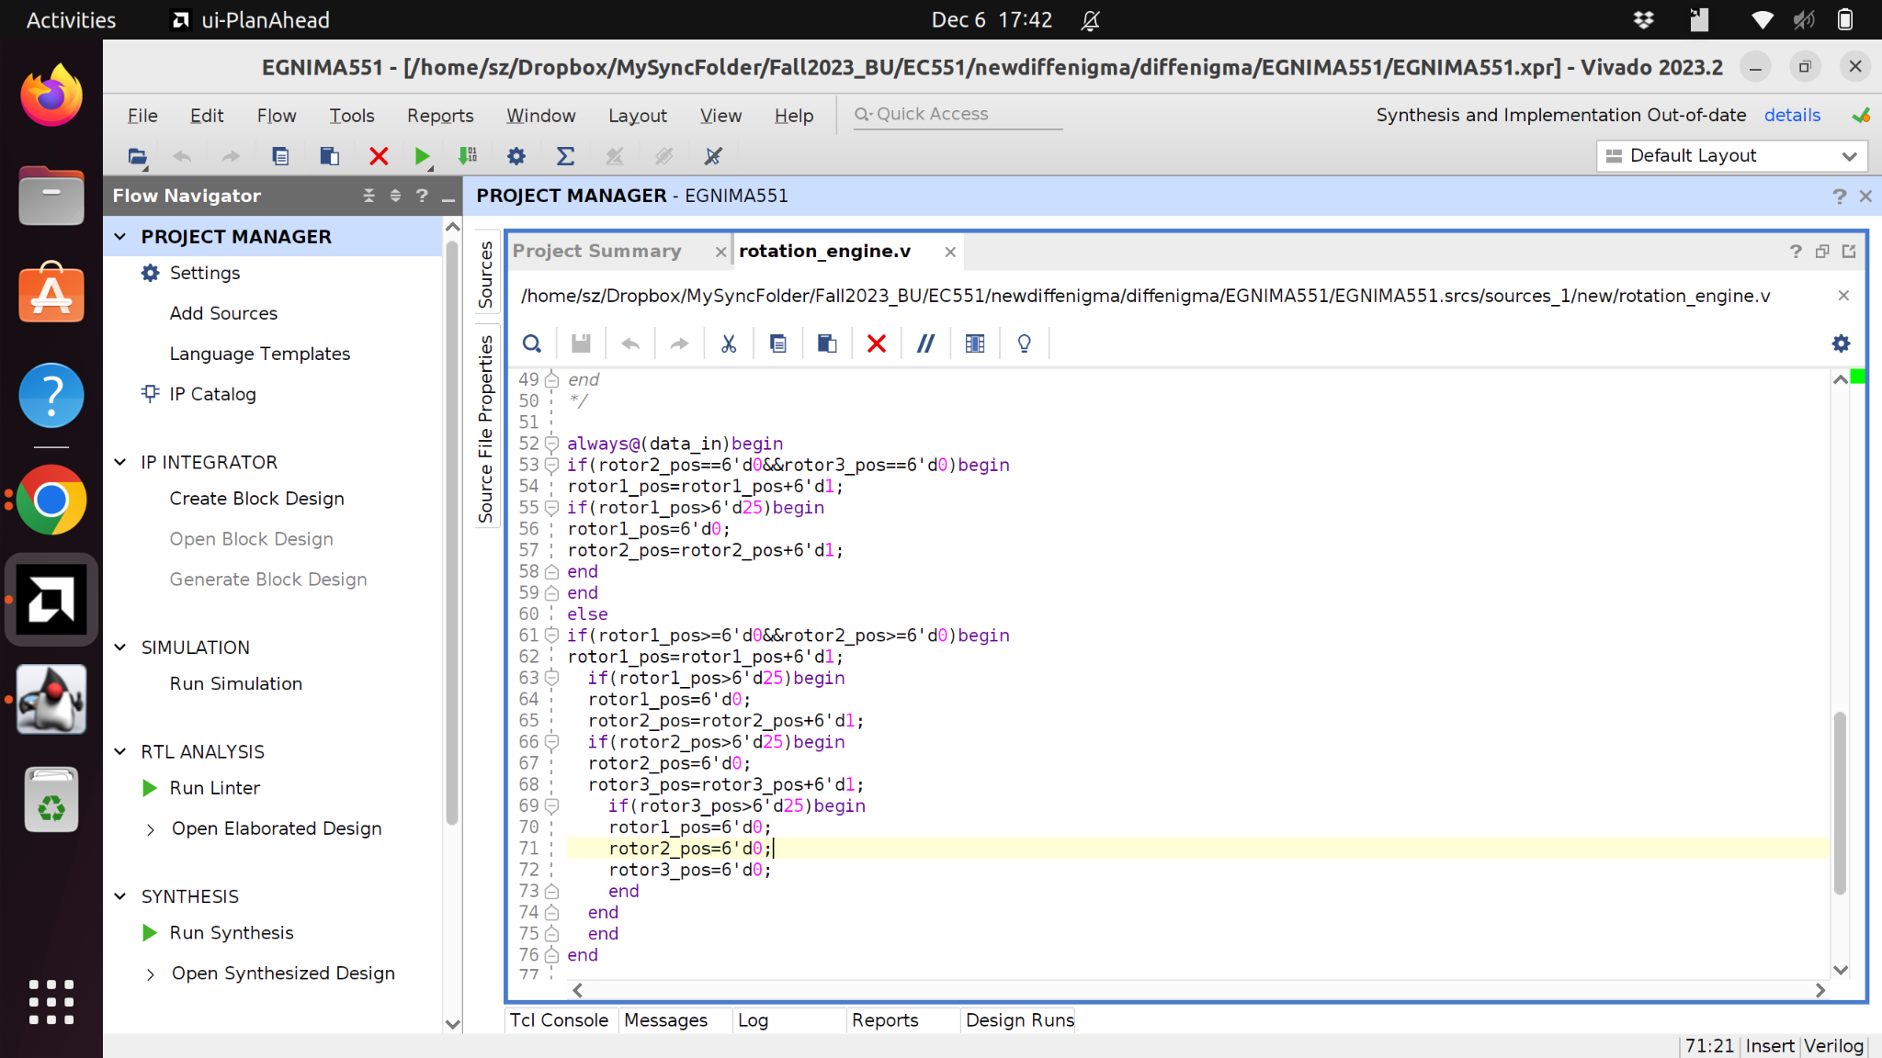
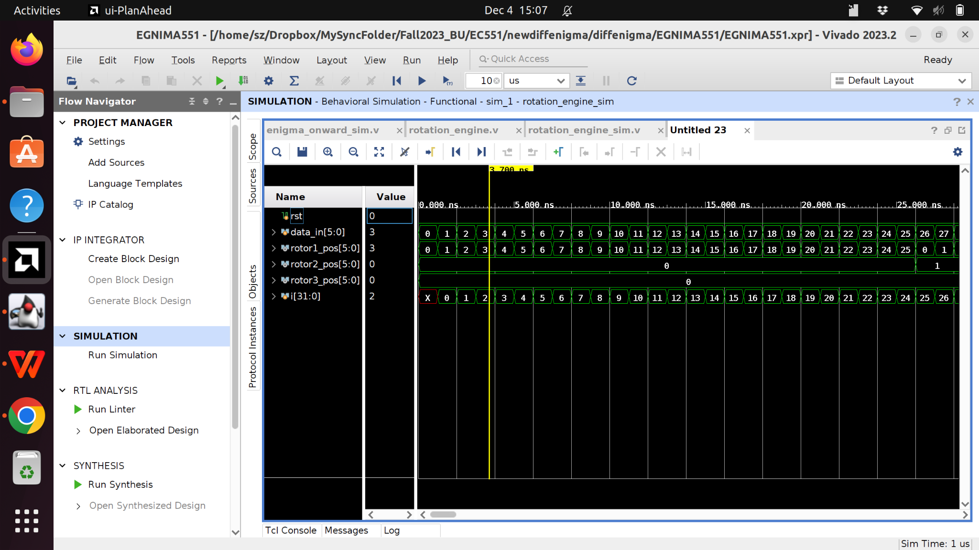
Rotation Test
Rotors are synchronized each time the sensitivity list is triggered. We use received signal to synchronize the rotors and output
Shizhe

Slide 17
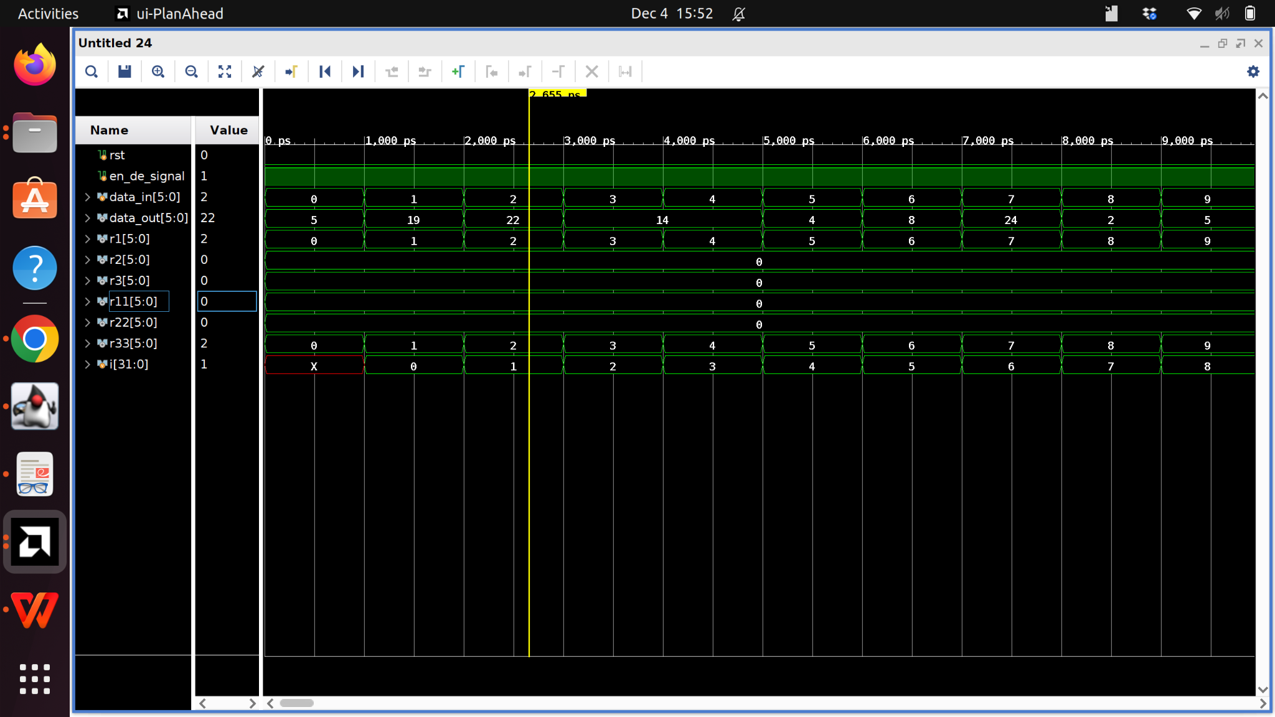
Encryption Test
Encryption is correct with the synchronization of rotors.
Only needs to connect it to UART
Shizhe

Slide 18
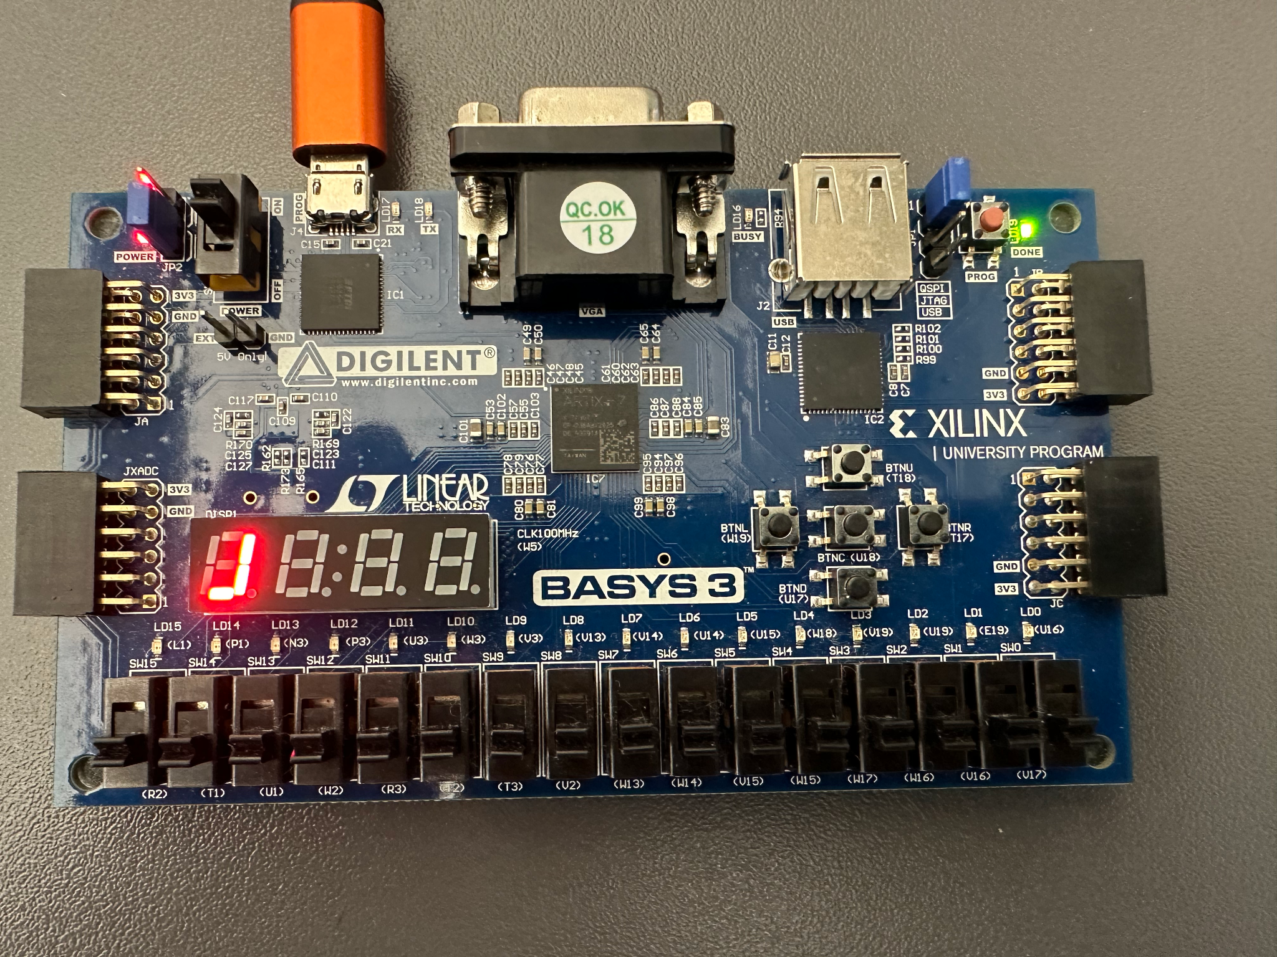
Use 7 segment to display the encrypted text
Certain letter patterns cannot be shown by 7 segment leds, and so we can add one more layer of encryption by mapping the encrypted texts to different patterns(such as the
position of the rotors)
(It doesn’t really have to be J)
Shizhe

Slide 19
Decryption(in progress)
The number of rotations will be recorded each time when the machine stops receiving data input.
To decrypt the output, we need to reverse rotate the positions.
We use first out last in strategy for reverse rotation.
For example:
KJLMANG mapped to EQGYINT, the final number of rotations are [2,2,3] respectively.
Then to decrypt the the encrypted, we set the reverse rotation rotors to position [2,2,3],
and type in the order as TNIYGQE, then it will give out GNAMLJK. Flip the output and
then you will have the original input.
Shizhe

Slide 20
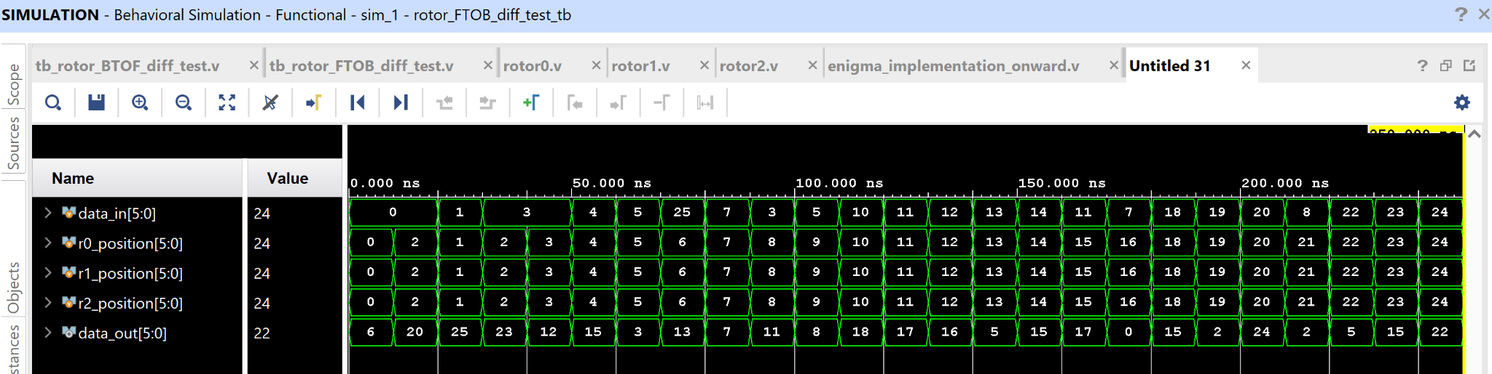
Encryption [rotor[front to back]] simulation
rotor_FTOB_diff_test uut (
.data_in(data_in),
.r0_position(r0_position),
.r1_position(r1_position),
.r2_position(r2_position),
.data_out(data_out)
);
initial begin
// Initialize inputs
data_in = 6'd0;
r0_position = 6'd0;
r1_position = 6'd0;
r2_position = 6'd0;
#10
data_in = 6'd1;
r0_position = 6'd1;
r1_position = 6'd1;
r2_position = 6'd1;

Slide 21
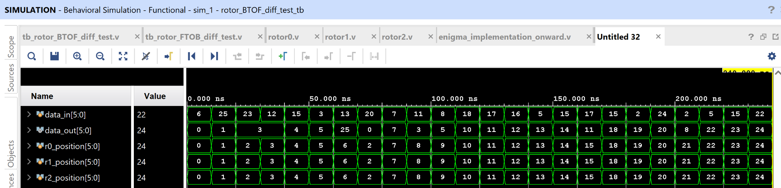
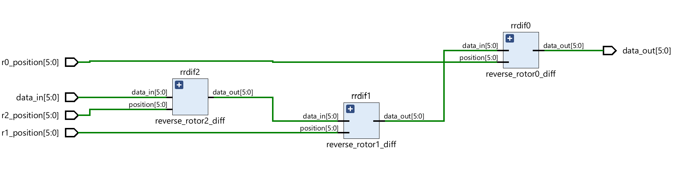
Decryption simulation [rotors[back to front]]
rotor_FTOB_diff_test uut (
.data_in(data_in),
.r0_position(r0_position),
.r1_position(r1_position),
.r2_position(r2_position),
.data_out(data_out)
);
initial begin
// Initialize inputs
data_in = 6'd0;
r0_position = 6'd0;
r1_position = 6'd0;
r2_position = 6'd0;
#10
data_in = 6'd1;
r0_position = 6'd1;
r1_position = 6'd1;
r2_position = 6'd1;
//……
data_out_decryption== data_in_encryption
position_decrypted= position_decrypt
Mayra

Slide 22
Reverse Rotation Test(in progress)
It’s still in the process of testing.
It’s separated from the encryption process.
It should be a different bitstream file
Shizhe

Slide 23
Python FPGA Master Program
A python application is used to interact with the enigma machine
Users can write their own messages, these messages will be translated into an array of integers
Each integer represents a letter, with A being represented as 0 and Z being represented by 25
The program can handle and remember spaces and capital letters, but not punctuation

Slide 24
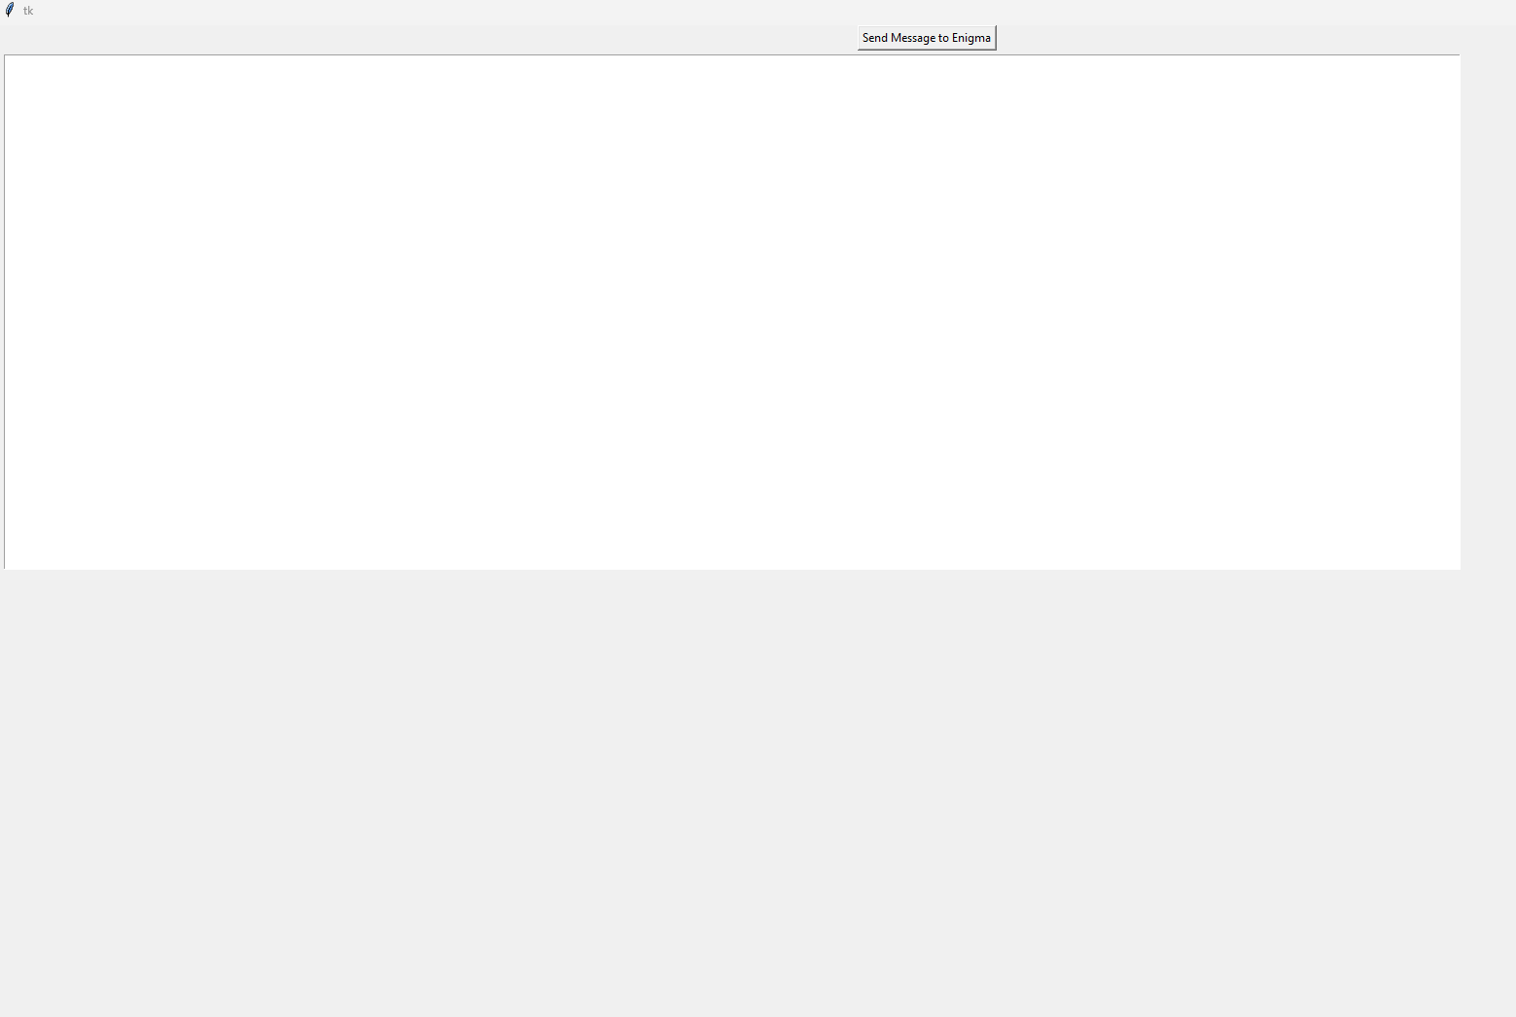
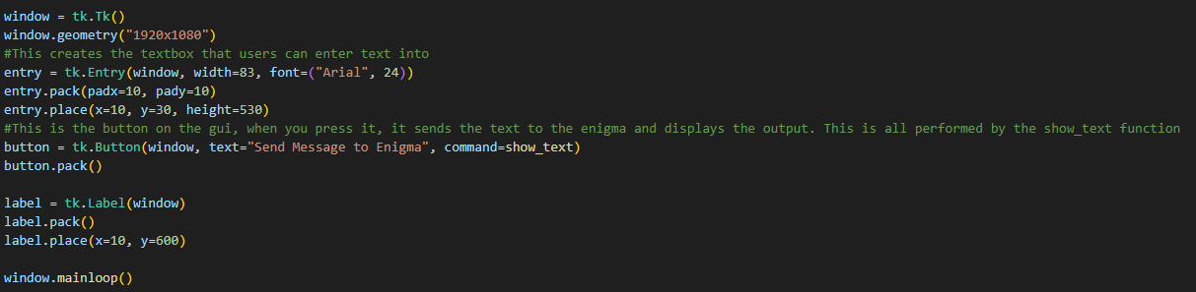
The GUI
Message to send to fpga
“Utilitarian”
Encrypted message returned by FPGA

Slide 25
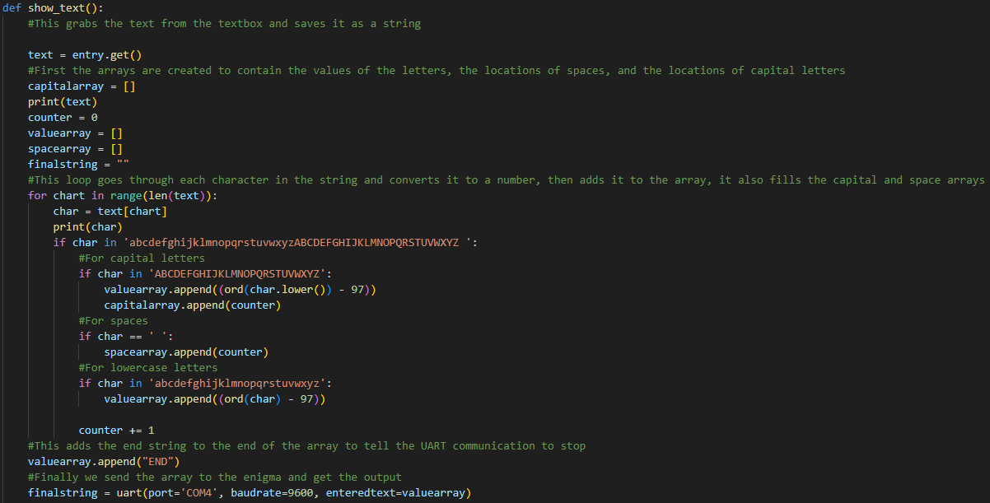
Message encoding

Slide 26
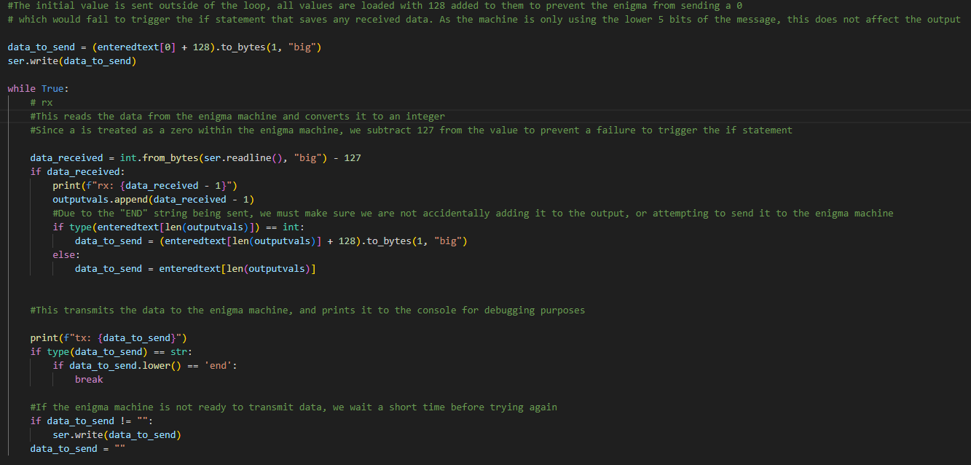
Message transmission

Slide 27
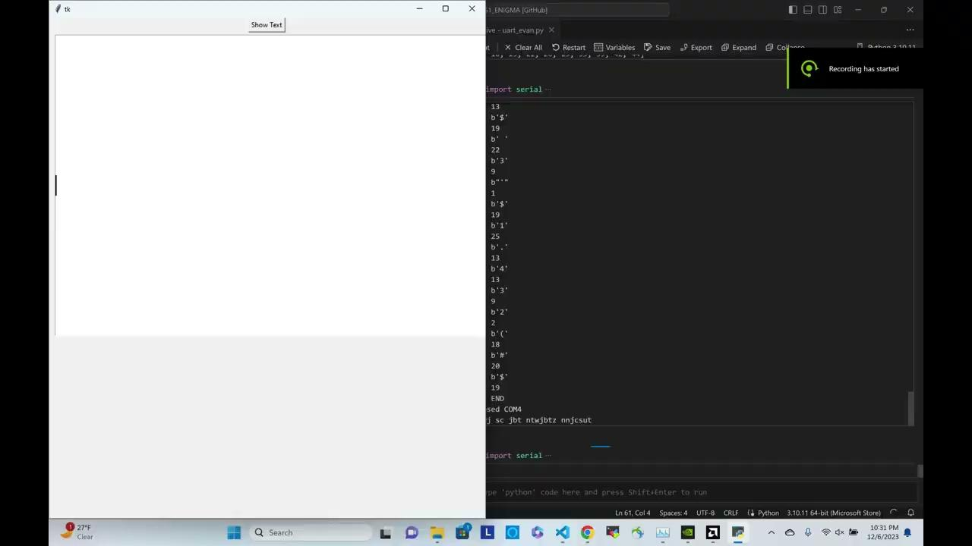

Slide 28
Successes
Successful implementation of the Enigma machine in the FPGA
Decryption of rotors from back to front using encrypted data and the positions of the rotors. Shown in simulation.
UART communication with the FPGA is complete
Successful implementation of encryption and decryption state on a FPGA
Implementation of a python master program is complete
Full support for english alphabet, including capital letters, and spaces
Successful circuit timing despite being a combinatorial loop
Mayra

Slide 29
Failures/ or in progress
Rotation triggered by input bit streams.
VGA display hasn’t been set up yet.
Reverse rotation has some bugs.
Mayra

Slide 30
Future work[ in 5 days from now]
Complete reverse rotation and decryption.
Make Uart trigger the rotation
Display through VGA

Slide 31
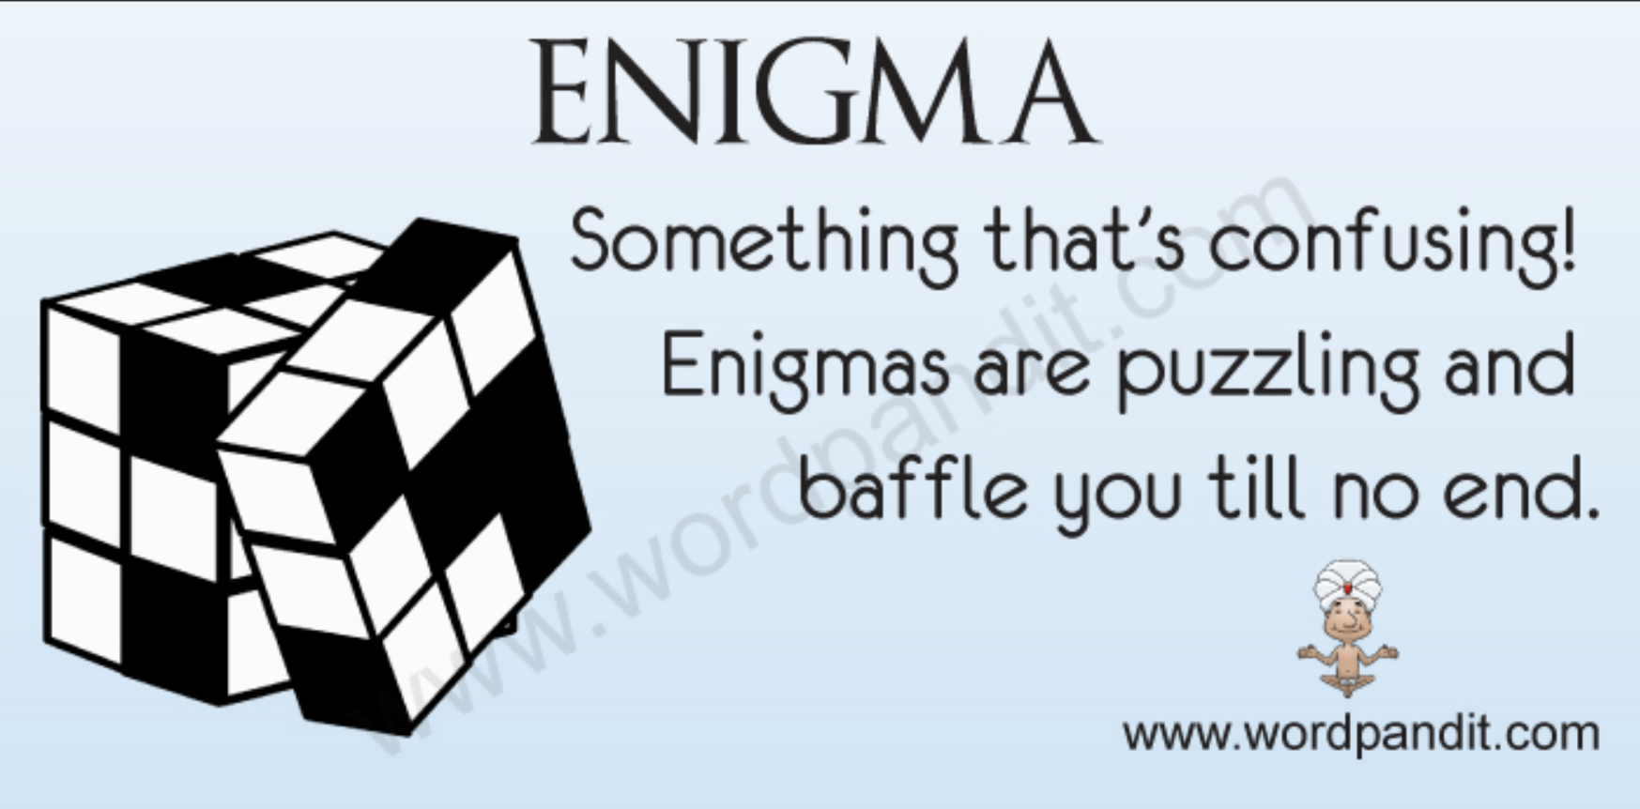

Questions

